Slide 1
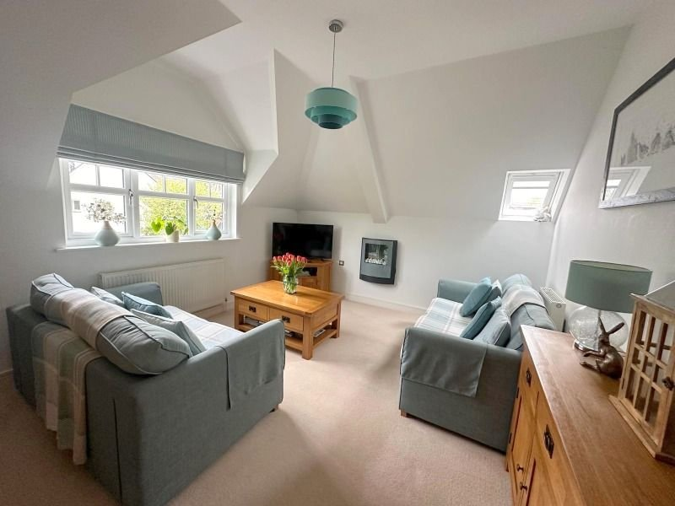
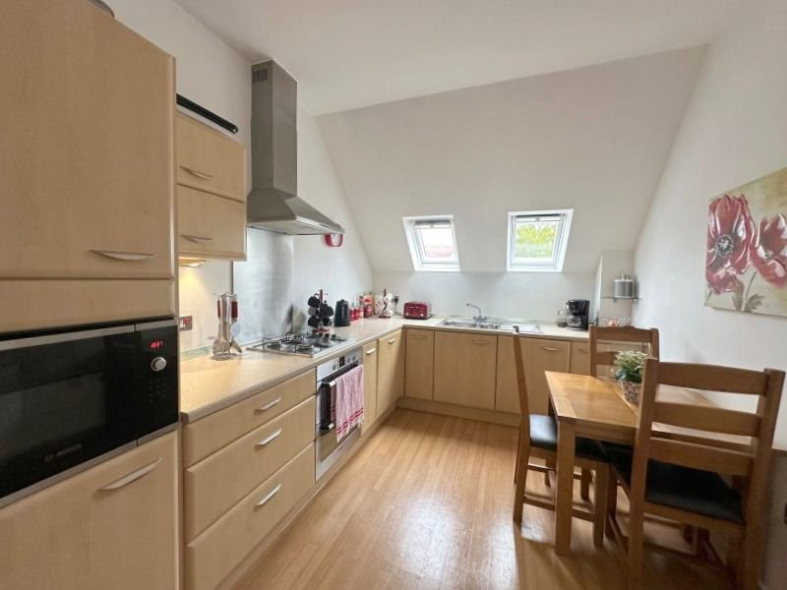
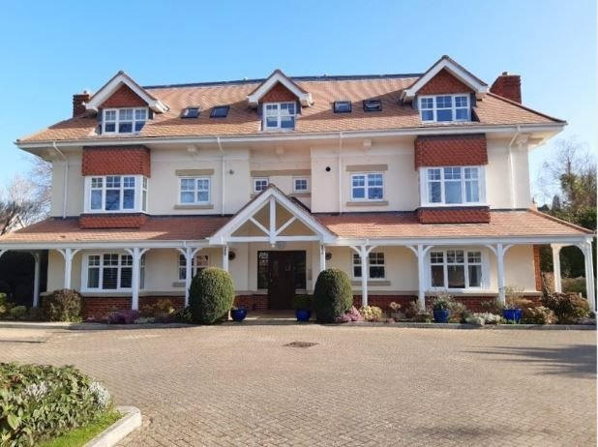
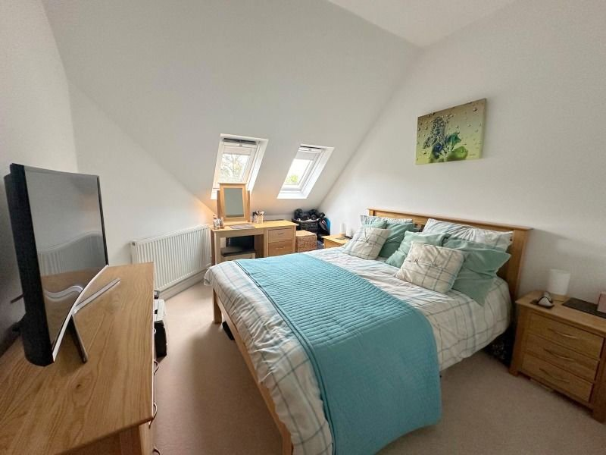
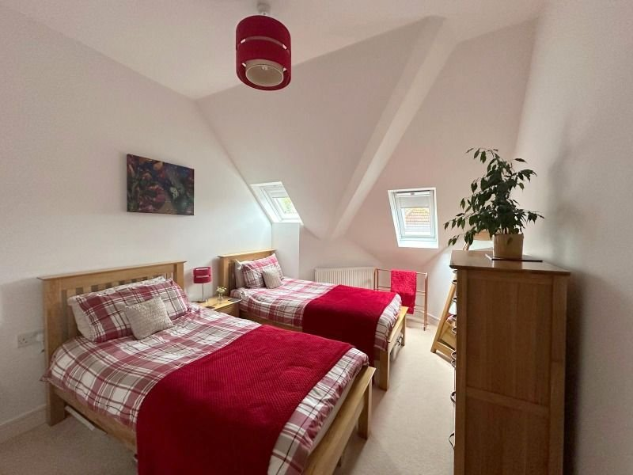
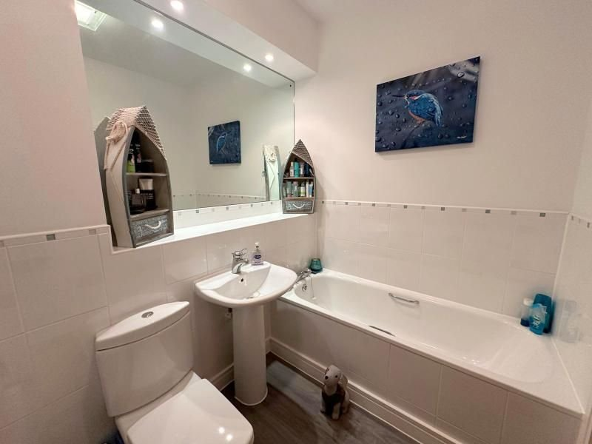
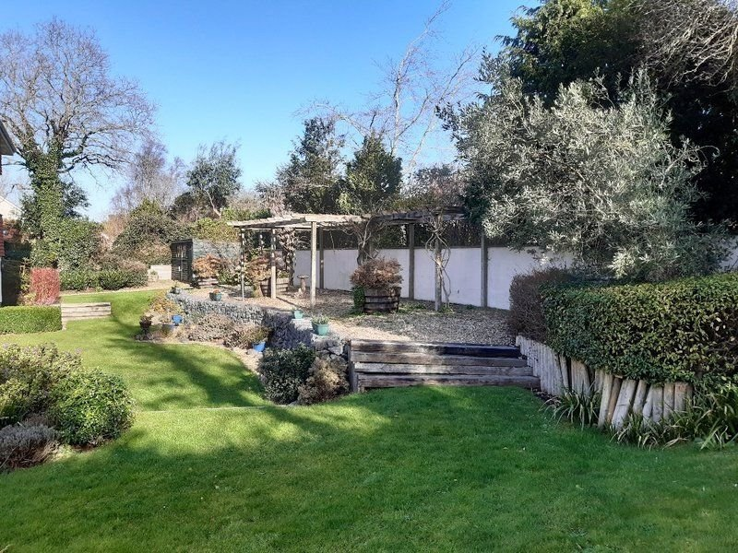
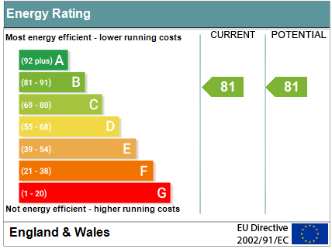
www.pennys.net
Flat 12 The Firs, 7 Sarlsdown Road, Exmouth, EX8 2HY
PRICE £270,000
TENURE Leasehold
A Light and Airy Beautifully Presented Two Bedroom Purpose Built Top Floor Apartment Situated In A Highly Sought After Location
Beautifully Presented Two Bedroom Purpose Built Top Floor Apartment • Lift And Stairs To All Floors • Quality Kitchen/Breakfast Room With Range Of Built In Appliances •
Lounge/Dining Room • Two Double Bedrooms •
Quality Bathroom/WC With Bath And Shower Cubicle • Separate Cloakroom/WC • Gas Central Heating & Double Glazed Windows • Attractive Communal Gardens •
Allocated Parking Space •
Pennys Estate Agents Limited for themselves and for the vendor of this property whose agents they are give notice that:- (1) These particulars do not constitute any part of an offer or a contract. (2) All statements contained in these particulars are made without responsibility on the part of Pennys Estate Agents Limited. (3) None of the statements contained in these particulars are to be relied upon as a statement or representation of fact. (4) Any intending purchaser must satisfy himself/herself by inspection or otherwise as to the correctness of each of the statements contained in these particulars. (5) The vendor does not make or give and neither do Pennys Estate Agents Limited nor any person in their employment has any authority to make or give any representation or warranty whatever in relation to this property.
PENNYS ESTATE AGENTS
2 Rolle House, Rolle Street, Exmouth, Devon, EX8 2SN
Tel: 01395 264111 EMail: help@pennys.net

Slide 2
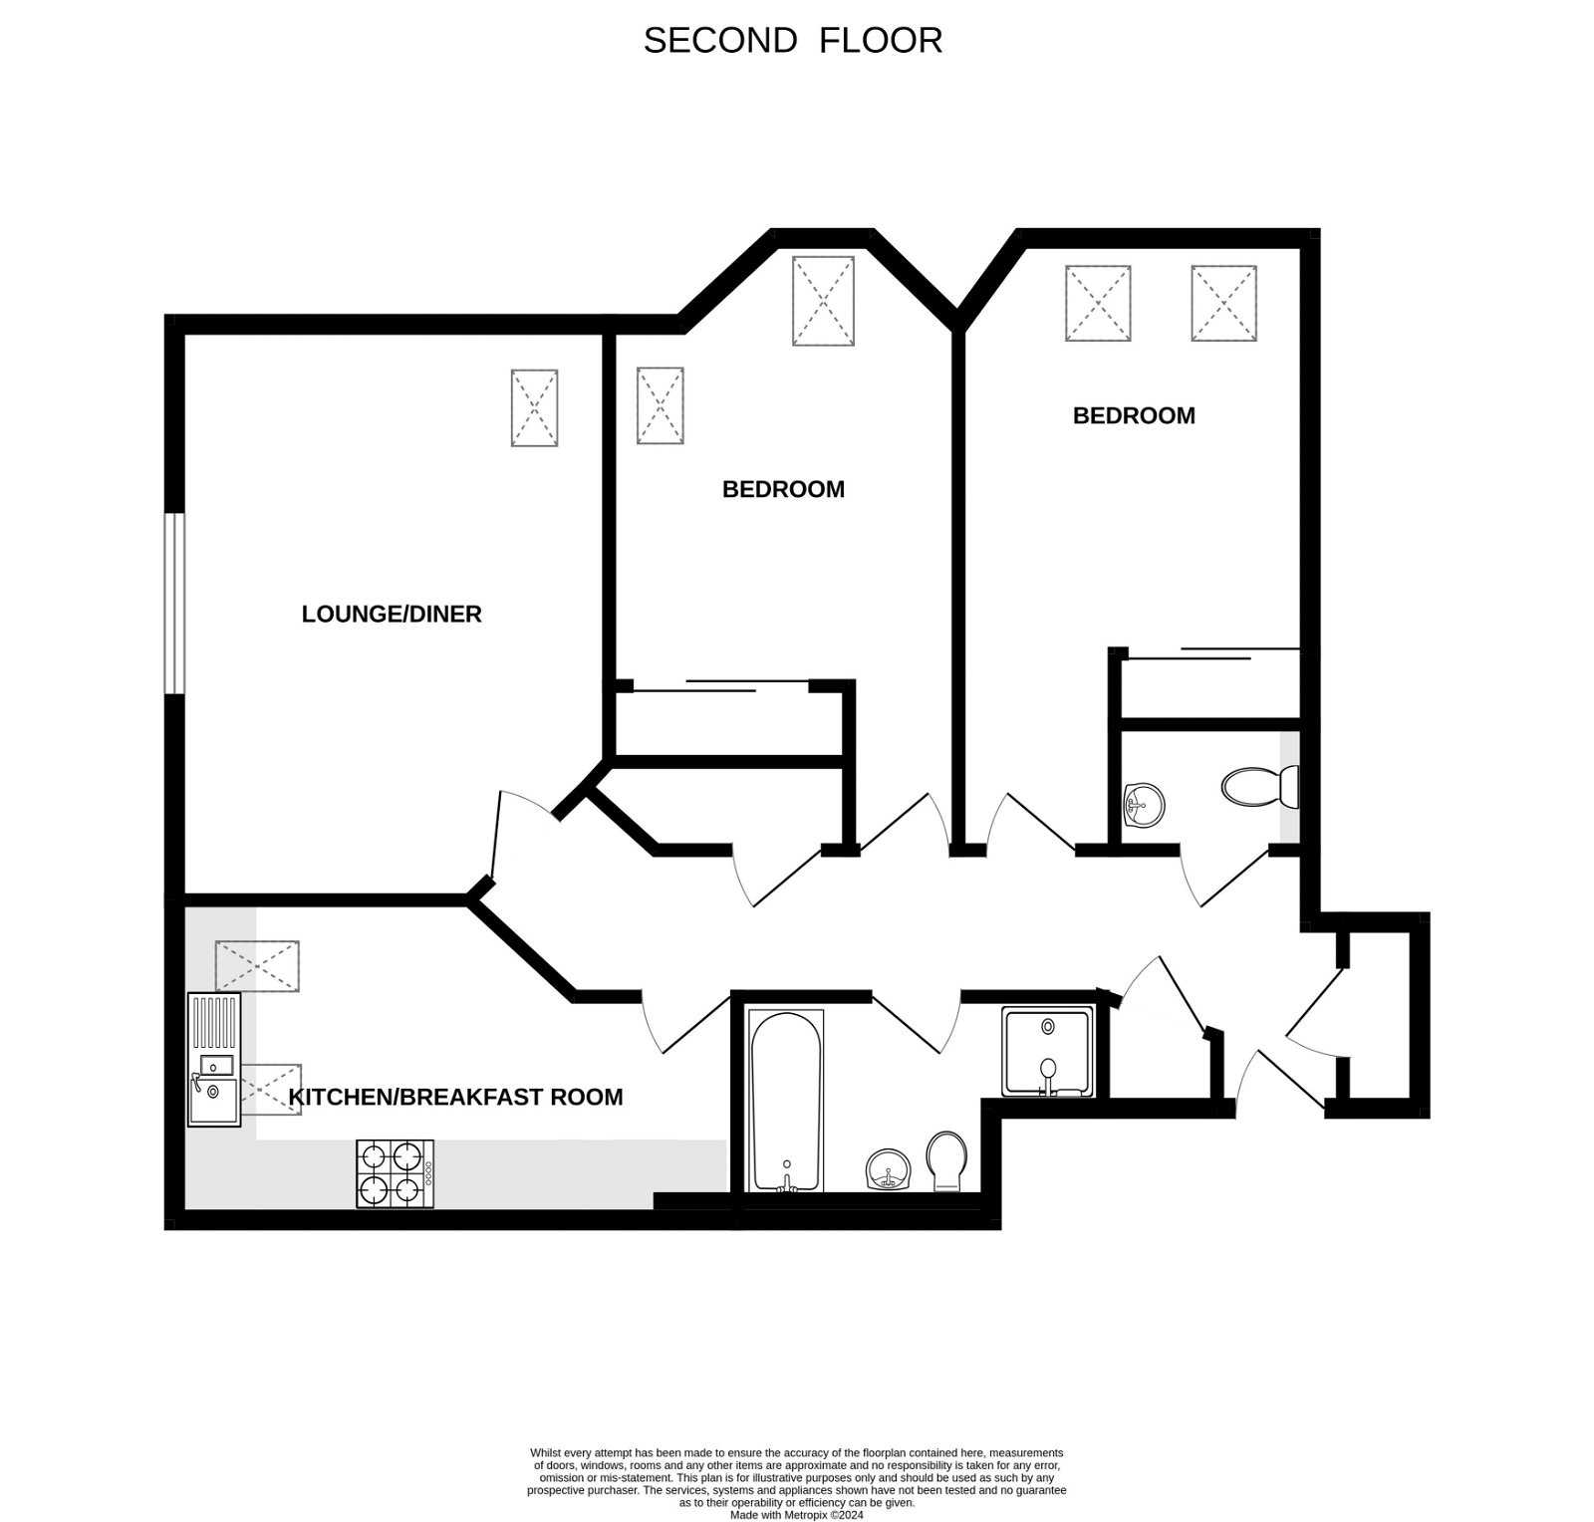
Flat 12 The Firs, 7 Sarlsdown Road, Exmouth, EX8 2HY
Occupying a prominent position in the desirable tree lined "Avenues" area of Exmouth with proximity to public transport, the apartment located on the top floor of the building has been beautifully kept and maintained and enjoys a quality kitchen/breakfast room, a most attractive lounge/dining room, two good size bedrooms, a quality bathroom suite/WC with bath and shower cubicle and a separate cloakroom/WC. Viewing of this apartment is strongly recommended.
THE ACCOMMODATION COMPRISES: COMMUNAL ENTRANCE: With door security entrance system with stairs and lift to top floor. Own private solid wood front door with spyhole to: RECEPTION HALL: With light tunnel; engineered wood flooring; smoke detector; alarm control panel; radiator; telephone point; door telephone entry system; good size linen cupboard with slatted shelf and hanging space; electric heater; further storage cupboard with coats hanging space; electric consumer unit; thermostat control for central heating; additional larder - style storage cupboard, doors giving access to all rooms. CLOAKROOM/WC: Fitted with wash hand basin; mixer tap over and tiled splash-back; WC with dual push button flush; radiator; extractor fan; engineered wood flooring. LOUNGE/DINING ROOM: 4.88m x 3.71m (16'0" x 12'2") Beautiful light and airy room with uPVC double glazed window overlooking the front aspect; and further uPVC double glazed velux window to the side aspect; wall mounted living flame pebble effect electric fire; power points. TV point; radiators; central ceiling light. KITCHEN/BREAKFAST ROOM: 4.83m x 2.74m (15'10" x 9'0") Maximum measurement. Fitted with a range of quality modern units with patterned worktop surfaces; inset one and a half bowl stainless steel single drainer sink unit with mixer tap over; built in Bosch microwave; built Bosch electric oven with inset four ring Bosch gas hob above; stainless steel splashback with matching chimney style extractor hood and light over; cupboards; integrated washing machine; and integrated dishwasher, built in fridge / freezer; matching range of eye level cupboards and base units below; wall mounted gas boiler serving domestic hot water and central heating; tiled splashbacks; power points; TV point; two double glazed Velux windows; radiator; engineered wood flooring; space for breakfast table; ceiling lights. BEDROOM ONE: 5.77m x 3.02m (18'11" x 9'11") Maximum overall measurement including doorway recess. A lovely bright room with two uPVC velux windows overlooking the side aspect; television point; power points; floor to ceiling fitted wardrobes with hanging and shelving space; radiator; ceiling light. BEDROOM TWO: 6.02m x 2.97m (19'9" x 9'9") Maximum overall measurement including doorway recess. Another bright room with two uPVC double glazed windows to the side aspect; telephone point; power points; floor to ceiling height fitted wardrobes with hanging and shelving space; radiator. BATHROOM/WC: Fitted with a quality suite comprising bath with taps over; pedestal wash hand basin with mixer tap over; WC with push button flush; enclosed shower cubicle comprising shower and attractive fully tiled wall; heated ladder towel rail; further tiled splashbacks; large fitted mirror with spotlighting over and useful shelf area; vinyl wood effect flooring.
OUTSIDE: The Firs is approached via a block paved driveway bordered by a lawned area with a variety of plants and shrubs and screened by a high level fence to the front of the property. To the rear of the building are superb communal gardens which are predominantly laid to lawn with a variety of trees, shrubs and plants. There is a high level decorative stone seating area and a large communal TIMBER SHED/STORE. The property also benefits from its own private PARKING SPACE. TENURE & OUTGOINGS: We understand that the property is held on a 199 year lease from 2006. The maintenance/service charges are approximately £2,867 per annum, with an annual ground rent of £125.
FLOOR PLAN:

